Slide 1
Praktikum 5 & 6
Doubly Linked List, Stack, Queue

Slide 2
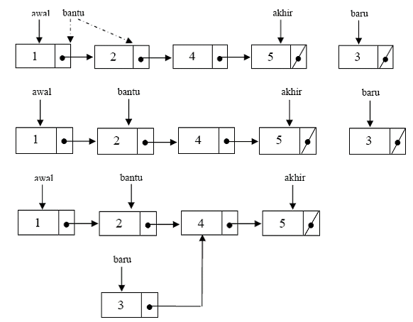
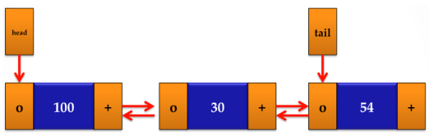
Single Linked List vs Doubly Linked List

Slide 3
Complete Doubly Linked List Code!
Example :
#include <iostream>
using namespace std;
struct node {
int value;
struct node *next;
…………
};
typedef struct node NODE;
prev
next
null
null

Slide 4
Ubah code single linked list menjadi double linked list!

Slide 5
Latihan Kontes Kuliah Tugas 3

Slide 6
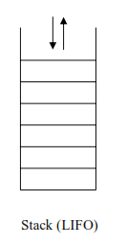
Stack
Konsep Stack : Last In First Out
Implementasi Stack :
Array
Linked List
STL
(http://www.cplusplus.com/reference/stack/stack/)

Slide 7
Operasi Dasar Stack
push(objek) : menambah objek ke dalam Stack
pop() : menghapus objek paling atas
top() : akses objek paling atas
empty() : memeriksa Stack kosong
size() : ukuran stack
full() : memeriksa Stack penuh (in array)

Slide 8
Kerjakan Latihan Praktikum Postfix

